Slide 1



City-To-City Peer Review Processes for Disaster Risk Reduction and Resilience Building: A Literature Review
Dr Jennifer Bealt
The University of Manchester
Jennifer.bealt@manchester.ac.uk
Prof Duncan Shaw
Dr Chris Smith
Dr Manuel Lopez-Ibanez
ASPA 2018 Annual Conference. March 9-13. Denver

Slide 2

Learner Outcomes
1. Provide a critical analysis of the extant literature to clarify conceptualizations and measures of disaster resilience.
2. To identify gaps in research and practice through a critical comparison of Making Cities Resilient campaign with the extant literature.
3. To identity implications for research and practice for resilience building.

Slide 3

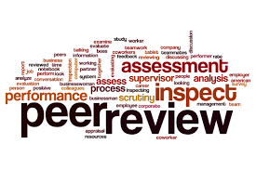
Why peer review?
Peer reviews are:
A governance tool where the disaster management systems of a country or city are examined by experts from another country or city.
This process can be desk-based or conducted in-country over a number of days.
Core aims:
Facilitate the exchange of good practices
Strengthen mutual learning and common understandings
Deliver independent, credible recommendations
(Pagani 2002).

Slide 4


UNISDR’s Making Cities Resilient (MCR) Campaign
What is MCR?
10 “critical and independent steps” for building and maintaining city resilience (UNISDR n.d, a):
1. Organize for disaster resilience;
2. Identify, understand and use current and future risk scenarios;
3. Strengthen financial capacity for resilience;
4. Pursue resilient urban development and design;
5. Safeguard natural buffers to enhance ecosystems’ protective functions;
6. Strengthen institutional capacity for resilience;
7. Understand and strengthen societal capacity for resilience;
8. Increase infrastructure resilience;
9. Ensure effective disaster response;
10. Expedite recovery and build back better.
Why MCR?
Inclusive campaign
Adopted by 3853 cities to date
Simple format

Slide 5
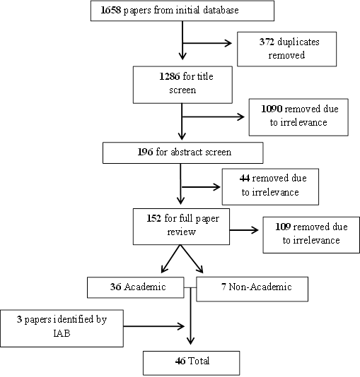
SLR Process
1658 papers retrieved
46 papers analyzed in full
33 characteristics

Slide 6

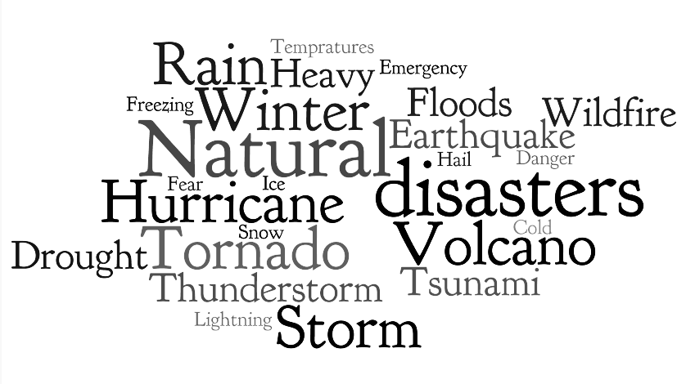
Findings and Discussion: Essentials 2 & 9.
Essential 2: Identify, Understand and Use Current and Future Risk Scenarios
MCR Definition: City governments should identify and understand their risk, including hazards, exposure and vulnerabilities, and use this knowledge to inform decision making.

Slide 7


Essential 2.
Social Dimensions
The need to identify a population’s exposure, vulnerability, susceptibility, and adaptive capacity (Birkmann et al. 2013).
Better targeting of risk information to populations (Cardona and Carreño 2011)
Better targeting of government attention to community resilience (Fleischhauer et al. 2012).
Structural dimensions
Physical structures, the environment and institutional characteristics (Fox-Lent et al. 2015)
The literature highlights the need for governments to consider risks from social deprivation, vulnerability and poor community inclusion (Birkmann et al. 2013).
It also addresses attitudes towards, risks (McAllister 2013) as well as willingness to commit to resilience strategies and adapt behaviors (Twigg 2009).
How societies manage natural resources, respond to the effects of climate change, and control land use (Basu et al. 2013).

Slide 8


Gaps in MCR for Essential 2
The SLR emphasizes the need to incorporate the private sector to support economic strategy and financial capabilities to mitigate risk.
Establishing alliances with environmental
services as a means of supporting resilience
and infrastructure protection were lacking in MCR.
Minimal reference in MCR to the importance of attitudes to the environment and disasters in improving resilience which could support adaptive change and a reduction in vulnerability.

Slide 9
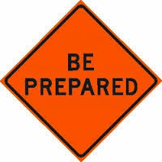

Essential 9: Ensure Effective Disaster
Response
MCR Definition: Ensure the creation and updating of disaster response plans are informed by risks identified in essential 2 and communicated to all stakeholders through use of organizational structures.

Slide 10

Essential 9.
Engaging and communicating
plans with all stakeholders is vital.
If citizens do not have access to preparedness or response activates their levels of resilience will be adversely affected (Ostadtaghizadeh et al. 2015).
Clear identification of resilience and exposure levels within communities (Basu et al. 2013).

Slide 11

Gaps in MCR for Essential 9
Financial assets as a means to tackle vulnerability through earmarked funds for response were not explicitly addressed by MCR.
Links with budgets or support from public-private partnerships to ensure effective response was also overlooked .
No considerations have been made in relation to managing spontaneous volunteers or unsolicited items.
Such influxes can complicate supply chains, pose logistical challenges, security risks, and strain critical services and infrastructure.
Part of managing these challenges is interlinked with effective communication during this phase so that additional help complements, not strains, the response system.

Slide 12

Measures: Essential 2
Measures: Measures for
understanding risk were based
on mortality rates (Mitchell et al., 2015) and impacts to infrastructure and environment (Keating et al., 2016).
Providing differing metrics for community and government level were proposed as a means of tailoring decision making (Mcallister, 2013).

Slide 13
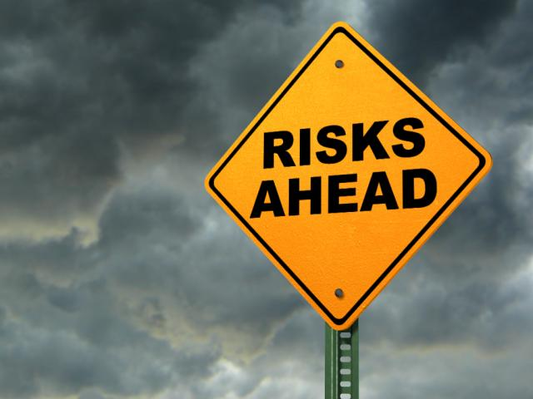
Measures: Essential 9
Measures: Measures for ensure
effective disaster response covered effectiveness of early warning systems, levels of risk analysis, number of people affected by disasters and numbers of deaths (Keating et al., 2016).

Slide 14
Challenges of Measuring Resilience
There were notable discrepancies across the literature bases in measuring resilience.
Whilst some provided clear numerical indicators for establishing city resilience such as mortality rates, others looked to societal indicators, such as deprivation levels.
These differing approaches can be separated into reactive and predictive measures of city resilience.
Peer reviews provide opportunities for statistical and qualitative data to be collated.
This allows cities to evaluate their resilience in a more meaningful way; using measures appropriate to their context.

Slide 15

Implications for resilience building in public administration
Addressing these topics from a public administration perspective unifies issues of disaster management, governance, policy, city management, and peer review.
MCR provides a useful framework for public administrators, but it is important to review its relationship with other bodies of literature and aspects it gives less prominence to.
The MCR framework uses a demarcated approach which focuses on: provision management and organization. The literature focuses on societal indicators as proxies of vulnerability.
The clear distinctions made by MCR are not reflected by the literature which has implications for what is expected of cities the feasibility of addressing resilience as independent steps.
Clearly demarcated approaches create “artificial distinctions between different aspects of the subject” (Twigg 2009, 13).

Slide 16


Questions

Slide 17
References
(Basu, M., Srivastava, N., Mulyasari, F., & Shaw, R. (2013). Making Cities and Local Governments Ready for Disasters: A Critical Overview of a Recent Approaches Risk, Hazards & Crisis in Public Policy 4(4): 250–273.
Birkmann, J., Buckle, P., Jaeger, J., Pelling, M., Setiadi, N., Garschagen, M., Fernando, N., Kropp., J., (2013). Framing vulnerability, risk and societal responses: The MOVE framework. Natural Hazards, 67(2), pp. 193–211.
Cardona, O. D., & Carreño, M. L. (2011). Updating the Indicators of Disaster Risk and Risk Management for the Americas. Journal of Integrated Disaster Risk Management, 1(1), pp. 27–47.
Fleischhauer, M., Flex, F., Greiving, S., Scheibel, M., Stickler, T., Sereinig, N., Koboltschnig, G., Malvati, P., Vitale, V., Grifoni, P., Firus, K., (2012). Improving the active involvement of stakeholders and the public in flood risk management: Tools of an involvement strategy and case study results from Austria, Germany and Italy, Natural Hazards and Earth System Science, 12(9), pp. 2785–2798.
Fox-Lent, C., Bates, M. E., & Linkov, I. (2015). A matrix approach to community resilience assessment: an illustrative case at Rockaway Peninsula. Environment Systems and Decisions, 35(2), pp. 209–218.
Keating, A., Campbell, K., Szoenyi, M., McQuistan, C., Nash, D., & Burer, M. (2016). Development and testing of a community flood resilience measurement tool. Natural Hazards and Earth System Sciences Discussions, (May), pp. 1–39.
Mcallister, T. (2013). Developing Guidelines and Standards for Disaster Resilience of the Built Environment: A Research Needs Assessment, pp. 1–142.
Mitchell, T., Hall, J., & Muir-wood, R. (2015). Setting , measuring and monitoring targets for reducing disaster risk international policy frameworks, 44(0), pp. 1–8.
Ostadtaghizadeh, A., Ardalan, A., Paton, D., Jabbari, H., Khankeh, H.R. (2015). Community Disaster Resilience: a Systematic Review on Assessment Models and Tools. PLOS Currents Disasters, available from: http://currents.plos.org/disasters/article/community-disaster-resilience-a-systematic-review-on-assessment-models-and-tools/, (accessed: 12/06/2017).
Pagani, F. (2002). Peer Review as a Tool for Co-Operation and Change, African Security Review 11(4): 15–24.
Twigg, J. (2009). Characteristics of a Disaster- Resilient Community: a Guidance Note. Aon Benfield UCL Hazard Research Centre.
UNISDR (United Nations Office for Disaster Risk Reduction), (n.d, a). About the Campaign, available from: http://www.unisdr.org/campaign/resilientcities/home/faq, (accessed: 26/06/2017).

